Slide 1


Welcome
Notes:
Getting Started:
Briefly go over the getting started section emphasizing the importance of planning and strategy in order to get alignment on your team and with your church’s direction and purpose.
Directions for Facilitator:
It is highly recommended that you go through the powerpoint presentation following along with your notes before your training session to ensure all slides, points and transitions are in sync with your notes.
To ensure an effective training session go over the material until you are comfortable and confident with your understanding of the material being presented.
Most of the slide content in the workbook will be in your leader notes. Where they are not you will see instructions to read off the slide.
You will also see the fill in for the workbook in a different color in your leader notes. Workbook content contained in the leaders notes are also a larger font than the leader notes.
All leader notes can be recognized by the bullet symbol at the beginning of this sentence.
If you have any questions about this content or need further clarification don’t hesitate to contact Ministry Advantage for assistance.

Slide 2
re-Activate Key Verses
Matthew 6:33
“But seek first his kingdom and his righteousness, and all these things will be given to you as well.”
Philippians 3:12-14
“…Forgetting what is behind and straining toward what is ahead, I press on toward the goal to win the prize for which God has called me heaven-ward in Christ Jesus.”
Notes:
First and foremost, we cannot stress this enough, If the church is to be re-ignited, re-activated or revitalized this verse provides us with our top priority.
Everything else is a distant second compared to to this.
If this step is overlooked we will never experience Gods redemptive plan for the future of the church.
Secondly if we are to move forward we must be willing to let go of some of the things from the past to embrace or implement new directions in the future.
We mustn’t forget the lessons of the past, milestones or blessings but build on them.
We must forget anything that hinders, holds back or keeps the church anchored to the past.
Two primary objectives – Seek & forget.
Forget doesn’t mean a memory wipe, whatever is in the past that holds you there, forget about it and whatever helps you to move forward learn from it and “PRESS ON”.
Question/Discussion:
What are some things churches normally are unwilling to let go of?
What things difficult usually difficult to let go of or change?

Slide 3
Phase One
Introduction

Slide 4
Biblical Basis for Planning
Planning Without God

Slide 5
Genesis 11:1-8
Now the whole world had one language and a common speech. 2 As people moved eastward, they found a plain in Shinar and settled there. 3 They said to each other, “Come, let’s make bricks and bake them thoroughly.” They used brick instead of stone, and tar for mortar. 4 Then they said, “Come, let us build ourselves a city, with a tower that reaches to the heavens, so that we may make a name for ourselves; otherwise we will be scattered over the face of the whole earth.” 5 But the Lord came down to see the city and the tower the people were building.

Slide 6
6 The Lord said, “If as one people speaking the same language they have begun to do this, then nothing they plan to do will be impossible for them. 7 Come, let us go down and confuse their language so they will not understand each other.” 8 So the Lord scattered them from there over all the earth, and they stopped building the city. 9 That is why it was called Babel[c]—because there the Lord confused the language of the whole world. From there the Lord scattered them over the face of the whole earth.
Notes:
There will be limited success if any when we don’t seek the heart of God and get direction from Him in preparing and planning for His Church.
Question: What was Gods plan? They were to multiply and fill the earth.
Genesis 9:1 Then God blessed Noah and his sons, saying to them, “Be fruitful and increase in number and fill the earth…. 7 As for you, be fruitful and increase in number; multiply on the earth and increase upon it.”
Genesis 1:28 ”God blessed them and said to them, “Be fruitful and increase in number; fill the earth and subdue it…”
Interesting note: What did God do to put a stop to the completion or the implementation of mans plan? He removed their ability to communicate.
Important:
If we cannot or will not communicate we remove our ability to cooperate.
When we don’t cooperate we can’t achieve alignment.
Without alignment or unity, which is a necessity for any plan or strategy to be successful, we cannot fulfill Gods plan.
Power of Alignment:
6 The Lord said, “If as one people speaking the same language they have begun to do this, then nothing they plan to do will be impossible for them.”

Slide 7
Key to Failure
4 Then they said, “Come, let us build ourselves a city, with a tower that reaches to the heavens, so that we may make a name for ourselves;

Slide 8
Biblical Basis for Planning
Planning Without God
Creation Strategy

Slide 9
Genesis 1:1-31
Six days of Creation
Notes:
Six days indicates a strategy and a plan since God could have created everything immediately.
There are multiple strategies build into this process…
It provided a day of rest.
Provided times of rest with the day and night. (prior to technology people worked in the daylight and slept in the dark)
It provided man with a balanced life of rest and work.
There is system of hierarchy, as man is in charge of everything.

Slide 10
Biblical Basis for Planning
Planning Without God
Creation Strategy
Preserving Creation Strategy

Slide 11
Genesis 6:11-14 & 22
11 Now the earth was corrupt in God’s sight and was full of violence 12 God saw how corrupt the earth had become, for all the people on earth had corrupted their ways. 13 So God said to Noah, “I am going to put an end to all people, for the earth is filled with violence because of them. I am surely going to destroy both them and the earth. 14 So make yourself an ark…
The Key to success…
22 Noah did everything just as God commanded him.
Notes:
Question: What was the Strategy?
Build an ark. (120 project)
Preach to the people during the building.
Gather two of every kind of animal.
Carry enough food for about a year.
The key to success…
22 Noah did everything just as God commanded him.

Slide 12
Biblical Basis for Planning
Planning Without God
Creation Strategy
Preserving Creation Strategy
Nation Building Strategy

Slide 13
Genesis 12:1-3
The Lord had said to Abram, “Go from your country, your people and your father’s household to the land I will show you. 2 “I will make you into a great nation, and I will bless you; I will make your name great, and you will be a blessing. I will bless those who bless you, and whoever curses you I will curse and all peoples on earth will be blessed through you.”
Key to Success:
4 So Abram went, as the Lord had told him;
Notes:
Abram – From one man God had a strategy for a nation of people to be in covenant relationship with him for generations to come.

Slide 14
Biblical Basis for Planning
Planning Without God
Creation Strategy
Preserving Creation Strategy
Nation Building Strategy
Salvation Strategy

Slide 15
Exodus 14
13 Moses answered the people, “Do not be afraid. Stand firm and you will see the deliverance the Lord will bring you today. The Egyptians you see today you will never see again. 14 The Lord will fight for you; you need only to be still.”….. 21 Then Moses stretched out his hand over the sea, and all that night the Lord drove the sea back with a strong east wind and turned it into dry land. The waters were divided, 22 and the Israelites went through the sea on dry ground, with a wall of water on their right and on their left.

Slide 16
Exodus 14
24… the night the Lord looked down from the pillar of fire and cloud at the Egyptian army and threw it into confusion. 25 He jammed the wheels of their chariots so that they had difficulty driving. And the Egyptians said, “Let’s get away from the Israelites! The Lord is fighting for them against Egypt.” 26 Then the Lord said to Moses, “Stretch out your hand over the sea so that the waters may flow back over the Egyptians and their chariots and horsemen.” 27 Moses stretched out his hand over the sea, and at daybreak the sea went back to its place. The Egyptians were fleeing toward it, and the Lord swept them into the sea. 28 The water flowed back and covered the chariots and horsemen—the entire army of Pharaoh that had followed the Israelites into the sea. Not one of them survived.
Notes:
Point of Interest:
Exodus 14:15 Then the Lord said to Moses, “Why are you crying out to me? Tell the Israelites to move on.
There comes a time when we must stop praying and execute the plan.
The strategy…
God led them the long way to the sea in order to avoid combat.
The whole series of plagues was part of the strategy to prepare Pharaoh to let the people go and demonstrate to the people the power of God.
The destruction of the Egyptian army kept Israel from looking over their shoulder wondering if they still might come after them.

Slide 17
Genesis 3
15 And I will put enmity between you and the woman, and between your offspring and hers; he will crush your head,and you will strike his heel.”
Notes:
That is strategic planning.
Thousands of years before it would happen God is planning for the salvation of us all.

Slide 18
Key to Success…
31 And when the Israelites saw the mighty hand of the Lord displayed against the Egyptians, the people feared the Lord and put their trust in him and in Moses his servant.

Slide 19
Biblical Basis for Planning
Planning Without God
Creation Strategy
Preserving Creation Strategy
Nation Building Strategy
Salvation Strategy
Battle Strategies

Slide 20
Joshua - Joshua 6
2 Then the Lord said to Joshua, “See, I have delivered Jericho into your hands, along with its king and its fighting men. 3 March around the city once with all the armed men. Do this for six days. 4 Have seven priests carry trumpets of rams’ horns in front of the ark. On the seventh day, march around the city seven times, with the priests blowing the trumpets. 5 When you hear them sound a long blast on the trumpets, have the whole army give a loud shout; then the wall of the city will collapse and the army will go up, everyone straight in.”

Slide 21
Gideon - Judges 7
7 The Lord said to Gideon, “With the three hundred men that lapped I will save you and give the Midianites into your hands. Let all the others go home.”….. 17 “Watch me,” he told them. “… When I get to the edge of the camp, do exactly as I do. 18 When I and all who are with me blow our trumpets, then from all around the camp blow yours and shout, ‘For the Lord and for Gideon.’” 19…. They blew their trumpets and broke the jars that were in their hands. 20 The three companies blew the trumpets and smashed the jars. Grasping the torches in their left hands and holding in their right hands the trumpets they were to blow, they shouted, “A sword for the Lord and for Gideon!” 21 While each man held his position around the camp, all the Midianites ran, crying out as they fled.

Slide 22
David - 1 Samuel 17
40 Then he took his staff in his hand, chose five smooth stones from the stream, put them in the pouch of his shepherd’s bag and, with his sling in his hand, approached the Philistine…. 45 David said to the Philistine, “You come against me with sword and spear and javelin, but I come against you in the name of the Lord Almighty, the God of the armies of Israel, whom you have defied. 46 This day the Lord will deliver you into my hands, and I’ll strike you down and cut off your head. This very day I will give the carcasses of the Philistine army to the birds and the wild animals, and the whole world will know that there is a God in Israel. 47 All those gathered here will know that it is not by sword or spear that the Lord saves; for the battle is the Lord’s, and he will give all of you into our hands.”
Notes:
Other example could be given of similar circumstances.
I am not a military strategist but what do you think would be the response if you approached your troops with some of these strategies?
Key issue is this…
Isaiah 55:8 “For my thoughts are not your thoughts, neither are your ways my ways,” declares the Lord.

Slide 23
Biblical Basis for Planning
Planning Without God
Creation Strategy
Preserving Creation Strategy
Nation Building Strategy
Salvation Strategy
Battle Strategies
Construction Strategies

Slide 24
Construction Strategies
The Tabernacle – Exodus 26:1-37
Solomons Temple – 1 Kings 6:1-38
New Jerusalem – Revelations 21:9-27

Slide 25
Biblical Basis for Planning
Planning Without God
Creation Strategy
Preserving Creation Strategy
Nation Building Strategy
Salvation Strategy
Battle Strategies
Construction Strategies
Evangelism Strategy

Slide 26
Matthew 28
19 Therefore go and make disciples of all nations, baptizing them in the name of the Father and of the Son and of the Holy Spirit, 20 and teaching them to obey everything I have commanded you. And surely I am with you always, to the very end of the age.

Slide 27
Acts 1
8 But you will receive power when the Holy Spirit comes on you; and you will be my witnesses in Jerusalem, and in all Judea and Samaria, and to the ends of the earth.”

Slide 28
Biblical Basis for Planning
Planning Without God
Creation Strategy
Preserving Creation Strategy
Nation Building Strategy
Salvation Strategy
Construction Strategies
Battle Strategies
Evangelism Strategy
Organizational Strategy

Slide 29
Acts 6
In those days when the number of disciples was increasing, the Hellenistic Jews[a] among them complained against the Hebraic Jews because their widows were being overlooked in the daily distribution of food. 2 So the Twelve gathered all the disciples together and said, “It would not be right for us to neglect the ministry of the word of God in order to wait on tables. 3 Brothers and sisters, choose seven men from among you who are known to be full of the Spirit and wisdom. We will turn this responsibility over to them 4 and will give our attention to prayer and the ministry of the word.”

Slide 30
Biblical Basis for Planning
Planning Without God
Creation Strategy
Preserving Creation Strategy
Nation Building Strategy
Salvation Strategy
Construction Strategies
Battle Strategies
Evangelism Strategy
Organizational Strategy
Leadership Selection Strategy

Slide 31
Moses - Exodus 3
4 When the Lord saw that he had gone over to look, God called to him from within the bush, “Moses! Moses!”….. 10 So now, go. I am sending you to Pharaoh to bring my people the Israelites out of Egypt.” 11 But Moses said to God, “Who am I that I should go to Pharaoh and bring the Israelites out of Egypt?”
Notes:
The Call…
Talk about the fact that God does not always call the capable and most talented.

Slide 32
Gideon – Judges 6
12 When the angel of the Lord appeared to Gideon, he said, “The Lord is with you, mighty warrior.” ….. 15 “Pardon me, my lord,” Gideon replied, “but how can I save Israel? My clan is the weakest in Manasseh, and I am the least in my family.” ….. 36 Gideon said to God, “If you will save Israel by my hand as you have promised— 37 look, I will place a wool fleece on the threshing floor. If there is dew only on the fleece and all the ground is dry, then I will know that you will save Israel by my hand, as you said.”

Slide 33
David – 1 Samuel 16
6 When they arrived, Samuel saw Eliab and thought, “Surely the Lord’s anointed stands here before the Lord.” 7 But the Lord said to Samuel, “Do not consider his appearance or his height, for I have rejected him. The Lord does not look at the things people look at. People look at the outward appearance, but the Lord looks at the heart.” ….. 11 So he asked Jesse, “Are these all the sons you have?” “There is still the youngest,” Jesse answered. “He is tending the sheep.” Samuel said, “Send for him; we will not sit down until he arrives.” 12 So he sent for him and had him brought in. He was glowing with health and had a fine appearance and handsome features. Then the Lord said, “Rise and anoint him; this is the one.”

Slide 34
Jesus Leadership Strategy
Luke 6
12 One day soon afterward Jesus went up on a mountain to pray, and he prayed to God all night. 13 At daybreak he called together all of his disciples and chose twelve of them to be apostles.

Slide 35
Failure vs Success
Failure comes when we…
Doubt
Are disobedient
Don’t do our part while trusting God to do His
Full of Pride
Act in unbelief
Are ungrateful
Success comes when we…
Have faith
Trust when we don’t understand
Are obedient
Don’t depend on our own understanding
We give it our all

Slide 36
State of The Church
Bible reading dropped to 20 year low of 31% in mid 90’s and returned to 47% by 2006
47% of declared Christians attend church
Small Group involvement in mid 90’s dropped to 17% and rebounded to 23% by 2006.
Church volunteering went from 30% in mid 90’s to 22% by 2006
Sunday School attendance in mid 90’s 17% and in 2006 24%
Of those who call themselves Christian 10% are more likely to be unchurched and 31% have not attended church in the last six months.
Notes:
(Barna Research January 2009)
Barna research has been tracking seven core religious behaviors for many years.
Of the seven the only two that haven’t changed over the last decade are Prayer & Evangelism.
The five core religious behaviors that have changed are:
Bible Reading…
Bible readership dropped to a 20-year low of just 31% in mid 90’a and returning 47% of adults reading the Book during a typical week by 2006.
That is the highest readership level achieved since the 1980s, according to the Barna tracking data.
Church Attendance…
In 1991 49% of adults attended church in a typical week
This dropped to 37% by1996, but climbed back to 47% by2006.
Small Group Involvement… (not including Sunday School)
In the mid 90’s this dropped to 17% and has rebounded to 23% by 2006.
Less than one out of five (18%) now attend during a typical week.
Church Volunteerism…
Whereas 30% of the self-identified Christians volunteered at a church during a typical week back in 1991, that figure has declined to 27% today.
Sunday School…
In the mid-90’s Sunday School dropped to 17% and has rebounded to 24%.
Although this are encouraging figures showing a slight rebound I the church it is still not reason to relax on efforts to re-Activate the church’s spirituality vitality.
Barna states…
"It is typical for us to see one or maybe two measures surge forward in a given year, only to stabilize or perhaps retreat to prior levels in subsequent years. The intriguing possibility is that with most of our key behavioral measures showing increases at the same time, there is the possibility that this may herald a holistic, lasting commitment to engagement with God and the Christian faith.”
Barna goes on to say that this is not reason to drop our guard and assume change has come but, “we certainly have a reason to hope that Americans are taking God more seriously, and a motivation for believers to pray more fervently that such a commitment will take root in our culture."
Those who embrace the label “Christian” for themselves are now ten percentage points more likely to be unchurched than was true in 1991. The 31% who fit this profile have not attended any church service during the past six months, excluding special services such as weddings or funerals.

Slide 37
State of The Church
26% claim their lives have been changed or affected greatly by attending church
25% claim church was somewhat influential in changing their lives
46% say their life had not been changed at all by attending church
61% could not remember any significant insight related to faith from last service attended
Those between the ages of 18-27 we less likely to describe positive outcomes when attending church
44% of church attendees claim to experience God’s presence weekly and 18% on a monthy basis.
Notes:
One-quarter of Americans (26%) who had been to a church before said that their life had been changed or affected “greatly” by attending church.
Another one-fourth (25%) described it as “somewhat” influential.
Nearly half said their life had not changed at all as a result of churchgoing (46%).
Three out of five church attenders (61%) said they could not remember a significant or important new insight or understanding related to faith. Among those who attended church in the last week, half admitted they could not recall a significant insight they had gained.
The youngest generation—a segment Barna Group labels Mosaics, ages 18 to 27—is significantly less likely to describe positive outcomes while attending congregations.
Among those who attend church every week, 44% said they experience God’s presence every week and 18% do so on a monthly basis.
While many church goers are receiving many positive inputs into their lives, experiencing the presence of God and feeling connected to a community of like minded believers, millions are not.
How can your faith community pray, identify, plan, and measure a deeper, more holistic set of experiences and outcomes so that people are not simply spectators of ministry but genuine participants.

Slide 38
State of The Church
________ of pastors report having no training on how to effectively lead and manage a church.
Over __________ ministers per month resign or are terminated.
Only one out of ten pastors will retire as a pastor.
The majority of church staffs struggle with relational conflict.

Slide 39
Where churches are at fault
Churches are too slow to change their methods.
Churches have failed to take advantage of their opportunities.
Churches don’t value evangelism.
Churches aren’t recruiting gifted leaders.
Notes:
(Aubrey Malphurs, “A New Kind of Church)
“If a young person in the early 21st century how they did church in America back in the mid-21st century all he or she has to do is visit an established, traditional church in the community.”

Slide 40
Proverbs 27:23-27
23 Know the state of your flocks, and put your heart into caring for your herds, 24 for riches don’t last forever, and the crown might not be passed to the next generation.
Notes:
Important: We need to understand where the church is a whole in the culture and more specifically where your particular church is as well.
In order to determine where the gap is relating to where you feel God is leading you it is important, first of all that you know where you are.
This starting point helps you determine your strategy for moving forward.

Slide 41
A Healthy Missional Church is…
One that loves God and loves people.
Matthew 22:36-40 (NLT) “Teacher, which is the most important commandment in the law of Moses?” 37 Jesus replied, “‘You must love the Lord your God with all your heart, all your soul, and all your mind.’ 38 This is the first and greatest commandment. 39 A second is equally important: ‘Love your neighbor as yourself.’ 40 The entire law and all the demands of the prophets are based on these two commandments.”

Slide 42
A Healthy Missional Church is…
One that loves God and loves people.
One that practices generosity
Acts 20:35 (NLT) “… remember the words of the Lord Jesus: ‘It is more blessed to give than to receive.’”

Slide 43
A Healthy Missional Church is…
One that loves God and loves people
That believes in generosity
One that humbly thinks of others more then themselves
Philippians 2:3 (NLT) “Don’t be selfish; don’t try to impress others. Be humble, thinking of others as better than yourselves.”

Slide 44
A Healthy Missional Church is…
One that loves God and loves people
That believes in generosity
One that humbly thinks of others more then themselves
One that is consistently serving the needs of others
James 1:27 (NLT) “Pure and genuine religion in the sight of God the Father means caring for orphans and widows in their distress and refusing to let the world corrupt you.”
Notes:
I would say that’s a pretty good church.

Slide 45
A Healthy Missional Church is…
One that loves God and loves people
That believes in generosity
One that humbly thinks of others more then themselves
One that is consistently serving the needs of others
One that has a passion for ____________ ____________
1 Corinthians 9:22b, “I have become all things to all people so that by all possible means I might save some. 23 I do all this for the sake of the gospel, that I may share in its blessings.”
Notes:
I would say that’s a pretty good church.

Slide 46
A healthy Church…
Doesn’t have to be perfect
It does have be the best it can be
Doesn’t have to be big
It does have to be welcoming
Doesn’t have to be wealthy
It does have to be generous
Doesn’t have to have be famous
But it does need to be humble
Notes:
What is a successful church or what does a successful church look like? Is it about numbers? Attendance? Buildings and property (good looks)? Etc?
We normally associate success with people, profits & power.
That’s the way the world measures success and we adopt that for the church. Lots of cults are successful on those standards.
Look first at the things we most often associate with success…
(Read off slide)

Slide 47
A Healthy Church
Is filled with people whose “actions” and “attitudes” are like Jesus.
Notes:
Sometimes we can perform Christ-like actions with un-Christ-like attitudes.

Slide 48
Healthy Church Culture
Simplified assimilation, structure’s, ministries & systems
Intentional environments for people to experience deeper relationship with God & a developing spiritual life
Clear communication about church and biblical expectations
Strong outward focus for multiplication
Celebrative and informal atmosphere
Notes:
(concepts taken from Simple Church)
1. Simplify
This is much more difficult then it appears.
In his book, “10 Stupid things that keep churches from growing” Geoff Surratt says that one of them is “Trying to do it all.”
To keep things simple and be effective the church must decide what it will do and won’t do.
It is better to be effective at three things then mediocre at 10.
This also safeguards the potential for burn out of the church volunteers.
In business terms we might say, “Cut the excess fat.”
For new people coming into the church there must be a simple process for them to get connected.
It is unlikely they will just find their way.
Ask the question, What are we doing that isn’t essential to fulfilling the purpose of the church? What program or activities can we cut and still fulfill our mission?
What are we doing that makes is difficult for people to get connected? Or What are we not doing?
Provide connection opportunities.
Recommended reading, “Simple Church” and “Essential Church”

Slide 49
Notes:
2. Deeper spiritual lives
Help people to connect with Gods presence.
In worship services, no matter if your church is big or small, remove all distractions so people can focus on God.
In worship choose songs that are God focused, memorable and easy to sing.
If you have small groups don’t allow them to become imbalanced toward the fellowship side.
Leaders need to provide meaningful time for the word and ministry.
3. Higher expectations
High expectations about leadership and leadership positions.
People need to feel comfortable and trust who is in charge in any area of ministry from the pastor down.
Expectations relating to security and safety including finance's, children and youth ministries.
Also expectations relating to serving in the overall efforts of the church in order to see the vision become reality.
Primarily it is about serving God with the gifts, skills and abilities he has given you, through His church.

Slide 50
Notes:
4. Outward focus
When reaching out to people, be real, be loving and be respectful.
Don’t sugar coat to get a decision.
Be consistent in your walk but don’t communicate perfection.
Create easy outreach events, weekends and activities for people to give invites to.
5. Celebrative atmosphere
This should especially be true of the worship.
But also of the interaction of the church attenders.
Is there a buzz in the room before and after service while people interact that demonstrates they enthusiasm to be together.
Atmosphere can also have to do with your physical location or worship and ministry areas.
Evaluate your environments and determine if you can improve the atmosphere.
Have a secret shopper come to your service and give you feedback. (even a non-christian)

Slide 51
Top Priorities of Pastors Survey
Assessing Mission & Vision
Revamping & Investing
Funding & Staffing
Church Size & Leaders Age
Notes:
(Barna Survey 2012, re pastors priorities to improve their churches in the next year)
Of the 12 possibilities these were the top four rated as a priority…
1. Assessing mission and vision.
59% said they were "definitely" going to "assess your church's vision and mission" in the next year.
Pastors also rated other forms of assessment higher than they did other priorities. This included "assessing their church's reputation in their community" (38%) and "measuring the demographic and spiritual needs of their community" (31%). These ranked two and three out of the dozen priorities.
2. Revamping & Investing
Most common priorities of pastors were "focusing on safety and security issues" (25%) and "revamping the budgeting and spending process" (25%).
Also included investing in "facilities and equipment for children" (22%), "audio and visual equipment" (19%), "facilities and equipment for youth and teens" (18%), and "technology and digital media" (18%).
3. Funding & Staffing
6% of churches said they would definitely "work with an organization to help increase giving" and only 2% were inclined to "hire a search firm to help you hire the right person."
While more than seven out of 10 churches (72%) rely on at least one outside consultant each year, getting such assistance for fundraising and staffing were generally perceived to be rare needs.
4. Church Size & Leader Age
Among churches with fewer than 100 adult attenders, most of the dozen priorities were of equal importance to those of larger church leaders. Yet small church pastors were less inclined to want community demographics, less focused on safety and security issues, less likely to change budgeting, and less inclined to invest in technology.
(remainder of notes on next hidden slide)

Slide 52
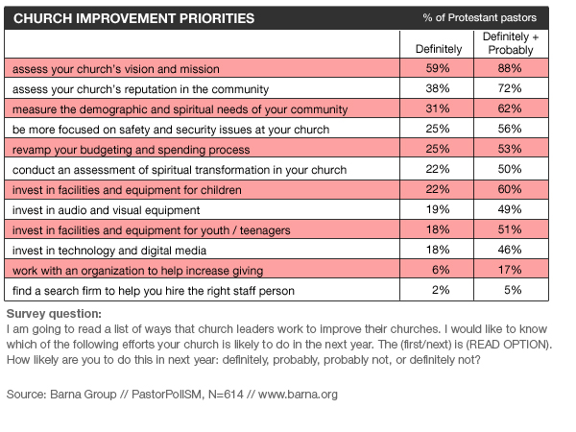
Notes:
Mid-sized churches (100-250 adults) were more likely than average to plan on investing in equipment for children, youth and teenagers as well as upgrading their audio and visual tools.
Large churches (251-plus attenders) were more likely than average to want to measure demographics, revamp financial processes, and work with fundraising consultants.
Pastors under 45 were more interested than average in technology and digital media, while those between the ages of 45 and 63 expressed above-average interest in fundraising help. Pastors who are ages 64 and older were higher than their peers when it came to measuring spiritual transformation.
Charts give an indication of what pastors are focusing on in the near future.
Question is, is it the right focus?

Slide 53
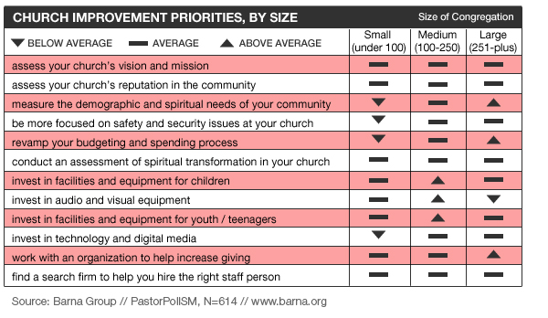

Slide 54
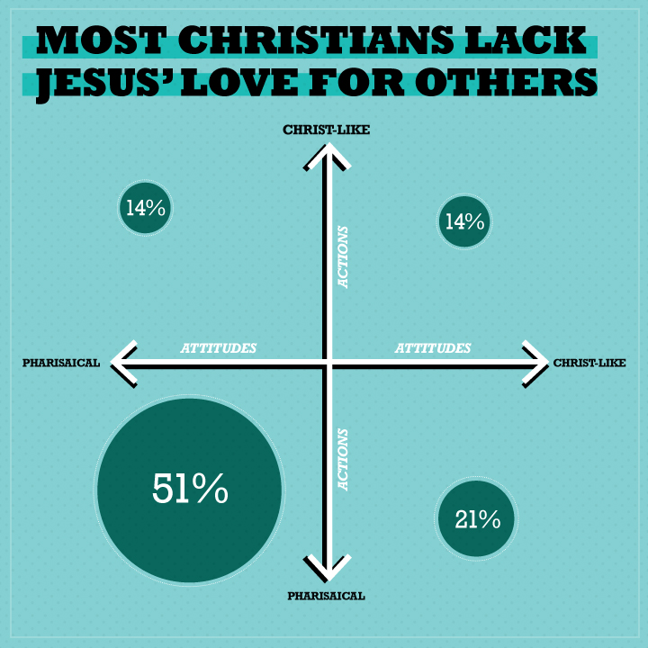
Challenge of the Church
Notes:
(Barna research 2013) https://www.barna.org/barna-update/faith-spirituality/611-christians-more-like-jesus-or-pharisees#.Uf_wbBal20u
Recent studies show Christians are…
More like the Pharisees in attitudes and actions then Jesus
Christians in the U.S. are characterized by having the attitudes and actions researchers identified as Pharisaical. Just over half of the nation’s Christians—using the broadest definition of those who call themselves Christians—qualify for this category (51%).
They tend to have attitudes and actions that are characterized by self-righteousness.
14% of today’s self-identified Christians—just one out of every seven Christians—seem to represent the actions and attitudes Barna researchers found to be consistent with those of Jesus.
About one-fifth of Christians are Christ-like in attitude, but often represent Pharisaical actions (21%).
Another 14% of respondents tend to be defined as Christ-like in action, but seem to be motivated by self-righteous or hypocritical attitudes.
An alarming 51% were found to be pharisaical in attitudes and actions.

Slide 55
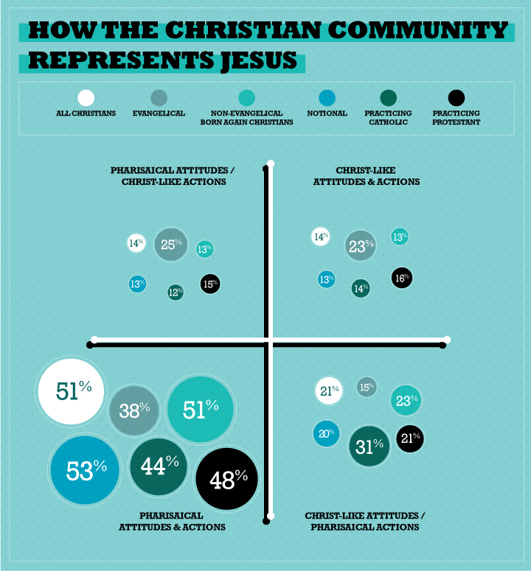
Notes:
Among those who identify as evangelical”—38% qualify as neither Christ-like in action or attitude, according to their responses to 20 questions.
About one-quarter (23%) of evangelicals are characterized by having Jesus-like actions and attitudes.
About half were a mixture of Christ-like actions and Pharisaical attitudes (25%) or vice versa (15%).
Interesting Note: Evangelicals are the only faith group more likely to be Pharisaical in attitude but Christ-like in action.
Note: Stats on slide.
Evangelical Christians are the most likely Christian segment to be categorized as having both the Christ-like actions and attitudes (23%) identified by Barna researchers.
84% of young non-Christians say they know a Christian personally, yet only 15% say the lifestyles of those believers are noticeably different in a good way.
Kinnaman explains: “This research may help to explain how evangelicals are often targeted for claims of hypocrisy; (Next Slide) the unique ‘sin’ of evangelicals tends to be doing the ‘right’ thing but with improper motives.”
We are much more likely and comfortable to point our the unrighteousness and immorality in our culture then point out the self-righteousness in our selves.

Slide 56
“The unique ‘sin’ of evangelicals tends to be doing the ‘right’ thing but with improper motives.”
(Kinnaman)

Slide 57
The challenge of the church is to address its own culture before attempting to significantly impact the culture in which it lives.
Notes:
Many Christians are more concerned with what they call unrighteousness than they are with self-righteousness.
It’s a lot easier to point fingers at how the culture is immoral than it is to confront Christians in their comfortable spiritual patterns.
Do people somehow get the message that the ‘right action’ is more important than the ‘right attitude’?
Do church leaders have a tendency to focus more on tangible results, like actions, because those are easier to see and measure than attitudes?
The research also indicates that many of the young generation are leaving the church due in large part to the hypocrisy they experience.
Galatians 2 (NLT) 11 But when Peter came to Antioch, I had to oppose him to his face, for what he did was very wrong. 12 When he first arrived, he ate with the Gentile Christians, who were not circumcised. But afterward, when some friends of James came, Peter wouldn’t eat with the Gentiles anymore. He was afraid of criticism from these people who insisted on the necessity of circumcision. 13 As a result, other Jewish Christians followed Peter’s hypocrisy, and even Barnabas was led astray by their hypocrisy.

Slide 58
3 Necessities in Moving Forward
Guidance of the Holy Spirit
Strong, servant Leadership
Clear & simple Strategy

Slide 59
Key Question
What are you prepared to Change?
If nothing is changing you don’t need a leader.

Slide 60
The art of leadership lies in how a person impliments change, not just in the change its self.
Notes:
(“Working With Emotional Intelligence”, Daniel Goleman

Slide 61
Change must be Lead
Management
Keeps things flowing in an orderly manner, provides direction and stability in order to ensure a focused and unproductive environment.
Leadership
Effectively handles the changes that come due to circumstances or issues within the organization.
Notes:
Leadership involves exciting people’s imaginations (and faith) and inspiring them to move in a desired direction. (D. Goleman)
Greatest difference between average and outstanding leaders was in their emotional style.
The most effective leaders where more positive, outgoing, expressive, warmer, more sociable, friendlier, more demorcratic, cooperative and fun to be with.
If there is nothing to change you don’t need a leader.

Slide 62
The
LIFE CYCLE of a Church

Slide 63
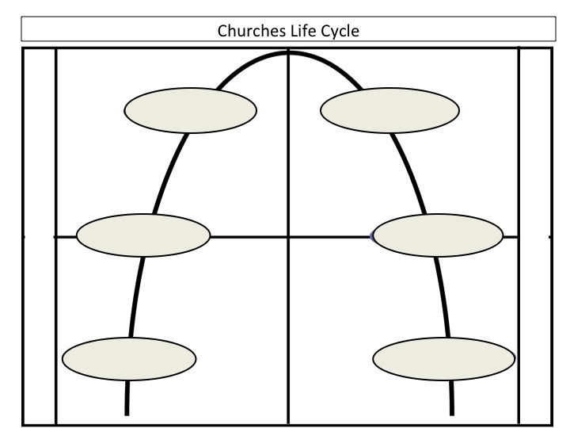
Maturity
Maintenance
Growth
Decline
Birth
Death
Notes:
(2004 Wesleyan Church Dept. of Evangelism)
Typical Pattern of Life Cycle Churches Follow:
Without some kind of intervention many, if not all, churches will find its self in one of these last three stages.
Too many churches will move through the stages to death without some intervention like re-Activate.
Although the time frame from stage to stage varies this is considered to be the shortest of all the stages. Yet this stage is the most crucial in defining the churches mission, culture and identity as it moves forward.
The founding pastor and members have the greatest impact on what shape and direction the church will take.
Graph demonstrates the typical life cycle of a church.
If you were to evaluate your church’s present condition, where would you place it on the cycle?
If critical measures are not between maturity and maintenance to reactivate the life of the church, decline is sure to come followed by, many times, a long painful death.
Don’t let your church be put on life support but recognize where you and pray for Gods wisdom as to what to do moving forward.
Various organizations have described a variety of terms to describe the life cycle stages and characteristics of each.
Before you can get to where you want to go you have to know where you are.
The TCAT helps churches get an honest look at how their members perceive they are doing in relation to spiritual transformation.
The results provide them with a snapshot of perceived strengths and perceived challenges based on the seven elements of a transformational church: missionary mentality, vibrant leadership, relational intentionality, prayerful dependence, worship, community and mission.

Slide 64
Notes:
How others have described the Life Cycles…
Steve Mills
The Infant Stage
The Growing Stage
The Prime Stage
The Aging Stage
The Dying Stage
W. Frank Walton
Risk Taking Stage
Caretaking Stage
Undertaking Stage
George Bullard
Growth
Prime
Redevelopment
Aging
Other
Birth
Incline
Recline
Decline
Death
These are different ways of saying the same thing.

Slide 65
The Healthy Missional Church
Life Cycle: Birth and Growth
General Characteristics
People Consistently…
coming to Christ
integrating scripture into life and ministry
engaging God in worship
active discipleship
serving with their gifts
loving and caring for each other
strong support for mission and vision

Slide 66
General Characteristics Cont’d…
praying together
working collaboratively with other ministries
living and giving generously and sacrificially
helping hurting people
living with a sense of hunger for God
working through conflict constructively
actively involved in evangelism

Slide 67
The Healthy Missional Church
Life Cycle: Birth & Growth
General Feelings…
Anticipation
Gratitude
Accomplishment
Enthusiasm and energy
Engaged
Unity and love
Chaotic at times
General Comments…
We sense Gods presence here.
We are glad to be a part of something special.
We are making a difference in this community and beyond.
We will do whatever it takes.
How can we keep moving forward with God?

Slide 68
Key Statement
“All things are possible.”
Key Verse
Acts 2:46, “They worshiped together at the Temple each day, met in homes for the Lord’s Supper, and shared their meals with great joy and generosity 47, all the while praising God and enjoying the goodwill of all the people. And each day the Lord added to their fellowship those who were being saved.

Slide 69
“The Stable Church”
Life Cycle: Maturity
General Characteristics
People occasionally…
… coming to Christ
… integrating scripture into life and ministry
… engaging God in worship
… growing in Christ
… serving with their gifts
… loving and caring for each other
… rallying around a compelling vision
Notes:
The plan is working we just need to keep doing what we are doing.
At this stage the church is also struggling with logistical problems as the crowds are larger then they have ever been.

Slide 70
General Characteristics Cont’d
People occasionally…
praying together
working collaboratively with other ministries
trusting one another and working in harmony
living and giving generously and sacrificially
helping hurting people
living with a sense of hunger for God
the people believing in the leaders and the leaders believing in the people
working through conflict constructively
embracing evaluation as normal and natural

Slide 71
“The Stable Church”
Life Cycle: Maturity
General Feelings…
Safe and comfortable for most
Low level of frustration for others who want more
Self sufficient
All in order organizationally
Passive People
Indifferent
General Comments…
We’re doing fine.
Who wouldn’t like our church?
We’re a warm and friendly church.
Problems will work themselves out.
If it ain’t broke don’t fix it.
Don’t rock the boat.

Slide 72
Key Statement
“It doesn’t get much better than this.”
Notes:
There is a false sense that everything is fine.
It is difficult for people to see the need for change at this point.
Their thinking is who wouldn’t like this church, we are such a warm, friendly and welcoming place.

Slide 73
Key Verse
Deut. 8:12 For when you have become full and prosperous and have built fine homes to live in, 13 and when your flocks and herds have become very large and your silver and gold have multiplied along with everything else, be careful! 14 Do not become proud at that time and forget the Lord your God, who rescued you from slavery in the land of Egypt…. 18 Remember the Lord your God. He is the one who gives you power to be successful…”

Slide 74
“The At Risk Church”
Life Cycle: Maintenance
General Characteristics
People sporadically…
coming to Christ
integrating scripture into life and ministry
engaging God in worship
growing in Christ
serving with their gifts
loving and caring for each other
rallying around a compelling vision
.

Slide 75
General Characteristics Cont’d
People sporadically…
praying together
working collaboratively with other ministries
trusting one another and working in harmony
living and giving generously and sacrificially
helping hurting people
living with a sense of hunger for God
the people believing in the leaders and the leaders believing in the people
working through conflict constructively
Accepts evaluation as normal and natural
Notes:
People no longer want to serve,
Fear of taking risks,
Ministry suffers for lack of leaders

Slide 76
“The At Risk Church”
Life Cycle: Maintenance
General feelings…
Anxious
Inadequate
Fearful
Confused
Insecure
Fight or Flight
General comments…
We are on a trajectory that we do not feel good about.
Why are people leaving?
Something is wrong.
Things are not like they used to be.
We have to do something.

Slide 77
Key Statement
“Houston, we have a problem.”
Notes:
Why are we losing people? Why aren’t people giving? Why, why, why?
This is a questioning stage as the church attempts to get a handle on the problem.
Find someone to blame, usually the pastor.
Quality of services begin to drop.
Programs begin to fall apart.
People react to fix the crisis rather than prayerfully responding to the problem.

Slide 78
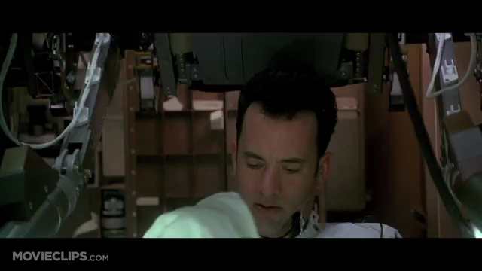
Clip from
Notes:
Clip from Apollo 13…
Demonstrates the somewhat relaxed and indifferent attitude of the crew.
Everything is routine, until something happens that is noticeable.
Eventually they understand they have lost the mission or purpose.

Slide 79
Key Verse
Proverbs 6:9 How long will you lie there, you sluggard? When will you get up from your sleep? 10 A little sleep, a little slumber, a little folding of the hands to rest—11 and poverty will come on you like a thief and scarcity like an armed man.
2 Chronicles 20:12b (NLT), “…We do not know what to do, but we are looking to you for help.”

Slide 80
The In Crisis Church
Church Stage – Decline & Death
General Characteristics
People are RARELY…
coming to Christ
integrating scripture into life and ministry
engaging God in worship
growing in Christ
serving with their gifts
loving and caring for each other
rallying around a compelling vision

Slide 81
General Characteristics Cont’d…
People rarely…
praying together
working collaboratively with other ministries
trusting one another and working in harmony
living and giving generously and sacrificially
helping hurting people
living with a sense of hunger for God
the people believing in the leaders and the leaders believing in the people
working through conflict constructively
embracing evaluation as normal and natural

Slide 82
The In Crisis Church
Life Cycle: Decline & Death
General Feelings…
Angry and blaming
Sullen
Inferior
Grief and loss
Denial
Betrayed
Defeated
Discouragement and hopelessness is prevalent,
General Comments…
Why even bother?
We must protect and defend.
If we only had _____ (fill in the blank) we would grow again.
Remember the good old days?
How will we survive this?
The pastor needs to go.
Where are all the young people?
Notes:
Looking with fondness at the way things used to be.
Reminiscing much like one would at the funeral visitation of a loved one.

Slide 83
Key Statement
“Things are not like they were in the good old days.”
Notes:
People spend a lot of time talking about the way things used to be,
How it was when a particular leader was there,
Reflecting on some great events of the pass and their impact.
“We used to” is a common expression.
They now see their best days as being behind them.

Slide 84
Key Verse
Ezekiel 37:3 He asked me, “Son of man, can these bones live?” I said, “Sovereign Lord, you alone know.” 4 Then he said to me, “Prophesy to these bones and say to them, ‘Dry bones, hear the word of the Lord! 5 This is what the Sovereign Lord says to these bones: I will make breath enter you, and you will come to life. 6 I will attach tendons to you and make flesh come upon you and cover you with skin; I will put breath in you, and you will come to life. Then you will know that I am the Lord.’”
Notes:
If a church does come to this stage it is important to celebrate the history, impact and influence this congregation has had in the past.
It is not impossible for this church to turn around but it will be very difficult and require divine intervention.

Slide 85
Life Cycle
Maturity
Maintenance
Growth
Decline
Healthy Churches Plan
Unhealthy Churches Solve Problems
Death
Birth
Notes:
[ Quickly hi-lite the six stages]
Birth: Initiation…move from concept to reality
Healthy church born out of a dream of a redemptive community. They take ownership of their vision
Growth: They clarify their beliefs… develop programs and policies. more and better disciples … infrastructure is being built…core leadership developed.
Maturity: Leadership defined…assimilation and growth structures in place … effectiveness in accomplishing mission and plans.
Maintenance: Structure, plans and programs begin to drive the organization. Policy/procedure driven…entrepreneurial leaders become restless.
Decline: Loss of momentum and leaders. Managers are in control (as opposed to leaders). Leadership base deteriorates to the point of threat to survival
.
Death: Initially it does not mean close the doors. Leadership base has become non-existent. History of past and struggles hold church hostage.
(CLICK) Healthy churches plan … unhealthy churches solve problems.
Structures become old wineskins when:
They are allowed to minister without supporting the mission.
They are not evaluated according to the mission.
They are unaware of how their action contributes to the accomplishment to the mission.
Plateau: Prolonged state of inactivity, leading to inward as opposed to mission focus.

Slide 86
Five Life Cycle Crises Points
Stagnation
Maturity
Maintenance
Leadership
Vision
Growth
Decline
Structure
Control
Birth
Death
Notes:
Five Crisis issues that occur during the life of a CHURCH:
Birth:
The dream in the heart of the church planting pastor and the core group becomes reality and a church is born.
Its early development requires organization for stability.
CRISIS is Structures .. Lack of ways to organize and operate
Crisis / Turning Point … Structure – add ministries, develop teams, etc.
Growth:
There is expansion in all areas.
Vision and strategy are clarified.
Current ministries are being strengthened and new ministries are started.
People are being added.
CRISIS is Leadership … Lack of additional leaders which inhibit ways to expand
Crisis / Turning Point … Leadership – more (and better) leaders at all levels
Maturity:
The church is growing up.
Everyone and everything is working together.
Steps are taken to optimize effectiveness and sustain growth.
The challenge is staying healthy!
CRSIS in Stagnation… intentional revitalization
Crisis / Turning Point … Renewal or Stagnation – Needing intentional reactivation

Slide 87
Notes:
Maintenance:
The church has stalled and moved into maintenance mode.
Some people are remembering better days.
Others are questioning the church’s direction and decisions.
CRISIS is Vision… Desire to protect the institution from people and change that will betray the past and accomplishments of the church.
Crisis / Turning Point … Vision – recapture the dream or develop a new one
Decline:
Problems are mounting. Ministries are dwindling. Resources are drying up.
People are pointing fingers and blaming each other for the sad state of church affairs.
CRISIS is Control… Desire to blame and absolve responsibility of decline.
Crisis / Turning Point …Control – survival means a battle for power
Death:
CRISIS: Who will conduct the funeral.

Slide 88
Life Cycle – Classic Responses
Maturity
Maintenance
Optimize
Nostalgia
Expand
Questioning
Growth
Decline
Clarify
Blaming
Organize
Polarization
Birth
Death
Dream
Leaving
Notes:
[ Quickly hi-lite the six stages]
Self explanatory, read off screen and expand on briefly.

Slide 89
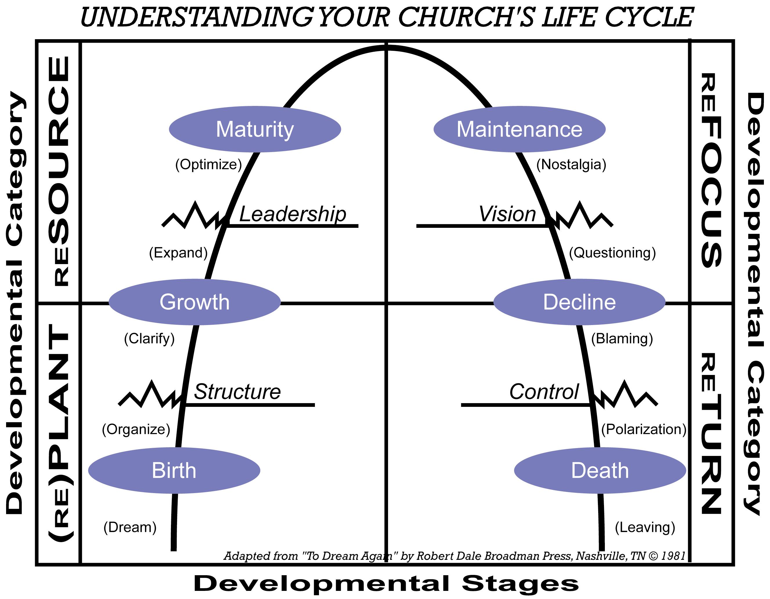
Reactivate Options
RESOURCE
REFOCUS
(RE)Plant
RETRUN
Notes:
Here are your options…
PLANT … A new church beginning in a community – either starting from “scratch” or launching with the help of a parent church, District or other sponsors.
(RE)PLANT … A completely new church that results from the closing of a previous one (sometimes started in same location with the existing facility) or an intentional starting over with the remnant of an unsuccessful church planting effort.
RESOURCE … A healthy and growing church that is fulfilling its vision – it simply needs fresh resources and it is usually asked to provide resources.
This church has the capacity of becoming a church-planting parent or partner, a model church and a teaching church.
REFOCUS … A maintenance-minded church that needs to clarify its vision and get back on mission to experience renewed growth patterns and regain its effectiveness. As it refocuses, this church will gain the capacity to become a church-planting parent or partner, a model church and a teaching church.
RETURN … A struggling church that must take aggressive steps to restore its mission and experience major turn-around in its ministries, if it is to ever have the potential of becoming a church-planting parent or partner, model or teaching church.

Slide 90
So what do we do?
Maturity
Maintenance
Growth
Decline
Death
Birth
Notes:
When the church is in free fall has been experiencing prolonged decline even returning to (CLICK) maintenance stage seems like success.
The problem is that decline will come quicker next time.
Drastic and possibly painfully uncomfortable measures are called for here.
(CLICK) but maintenance status is not an option.

Slide 91
So what do we do?
Maturity
Maintenance
Growth
Decline
Dream Again
Death
Birth
Notes:
Question: Where does this church need to focus?
(CLICK) It needs to dream again.

Slide 92
The Point
Maturity
Maintenance
Growth
Decline
The Further Down
The More Difficult The Recovery
Death
Birth
Notes:
What is the point?
The realization that the further down you go…. The more difficult the prospect of reactivation.

Slide 93
Life Cycle
Best time to ReFocus?
Maturity
Maintenance
Growth
Decline
Death
Birth
Notes:
Question: When is the optimal time for reactivation to begin?
In the very early stages of plateau.

Slide 94
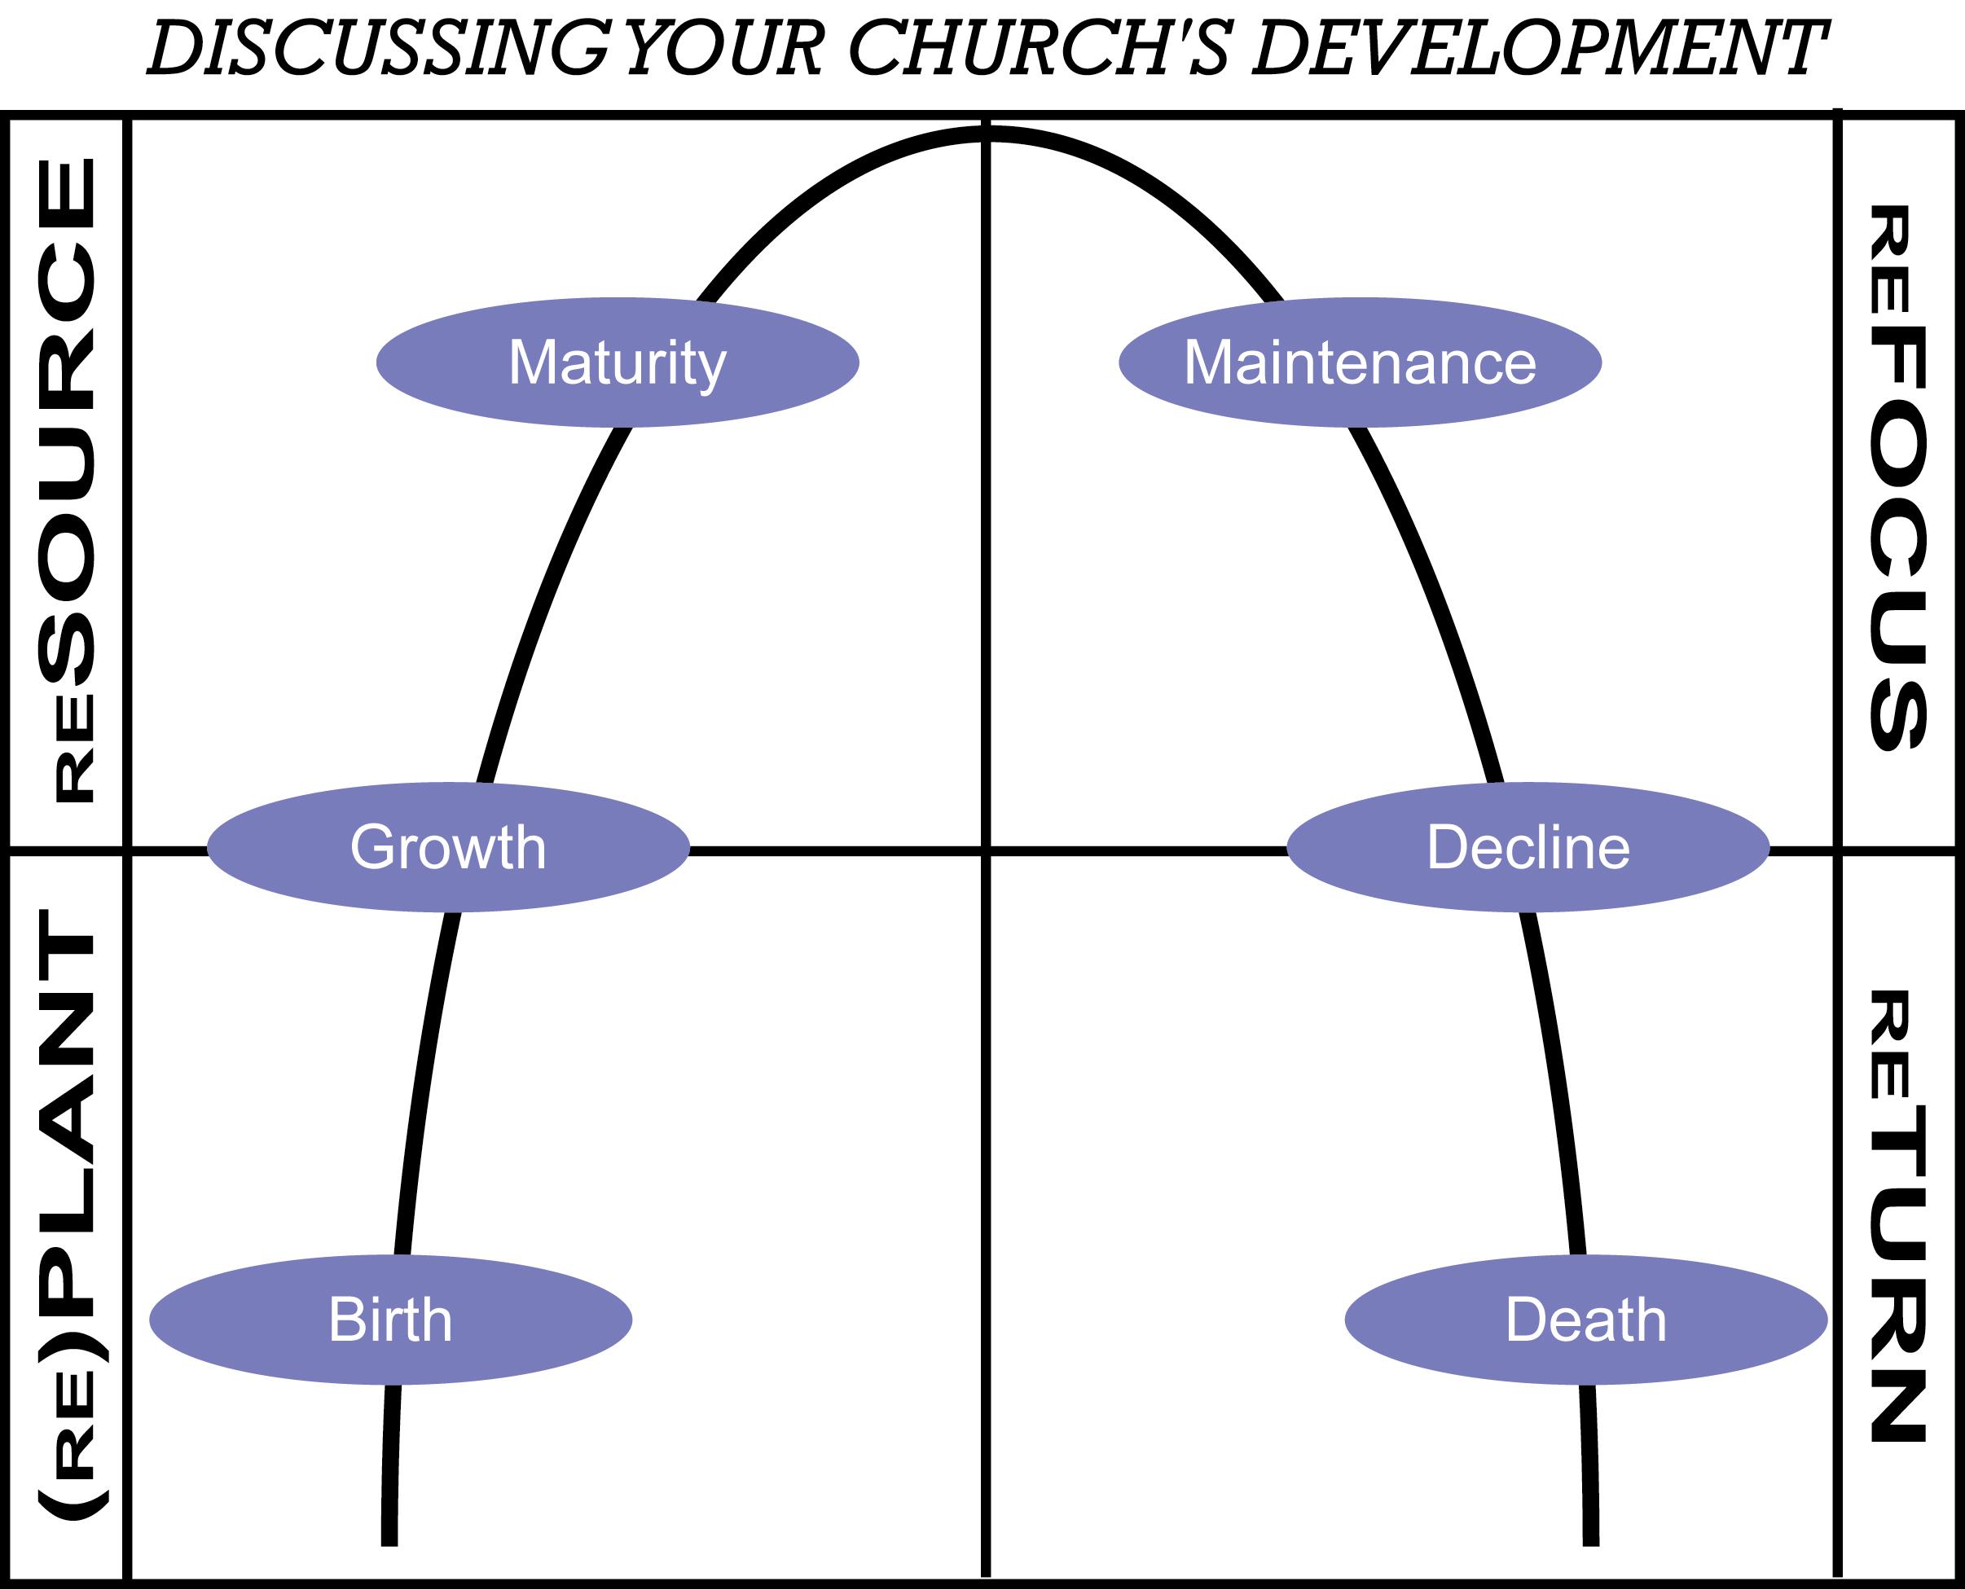
Which Category Best Describes Your Church
At Risk Church
^{Mature}
^{Maintenance}
Stable Church
^{Growth}
^{Decline}
Missional Church
^{Birth}
^{Death}
In Crisis Church
Notes:
Discussion: Think about how you would answer the following questions yourself, then discuss your
Responses as a leadership team …
1. In your opinion, where is your local church on the Life Cycle? Check the box in your notes that indicates the description you feel your church is. Why do you believe this?
2. Based on the “general characteristics” discussed earlier, do you agree or disagree with this as a description of your local church? Why or why not?
3. What key factors are influencing or support your opinion about your church’s overall health? (List them under the characteristic you chose)
4. What numerical and financial trends during the last five years support your assessment?
5. What issues need to be addressed as your church strives to improve its overall health?
6. If it is time for intervention in your church’s life cycle, what steps will you take to launch into new growth patterns?
Consider – What are the possibilities of drawing paralells to interventions for people who are in trouble of some sort, either drugs, alcohol, drugs, finances etc, to a church that is struggling or in trouble.

Slide 95
Becoming a Healthy Missional Church
10 Essentialsof a Healthy Chruch
Healthy churches are passionate about…
Loving Relationships
Servant Leadership
Following God anywhere
Welcoming EVERYONE
Developing Life Changing Ministries
Healthy Churches develop a Culture of…
Generosity
Gratitude to God
Personal development
Simple structures and processes
Spiritual development
Notes:
(Note – I think we can draw more parallels here to physical health and church health).
Make some comparisons here to physical health essentials.
What are the essentials for physical health?
What are the essentials for church health?
We must be careful to make sure our essentials are biblically based and not traditionally based.
This is the goal of reactivate, to see each church healthy, vibrant and fulfilling its divine call for kingdom growth.
When developing church health you focus urgency on the area of ill heath but you don’t ignore the healthy areas.
A athlete who discovers he has an injury doesn’t ignore his diet, rest, etc. He/she simply addresses the injury and recovery while keeping everything else as optimal as possible in order to get back in the game as quickly as possible.

Slide 96
Seven Sins of Dying Churches
Doctrine Dilution
Loss of Evangelistic Passion
Failure to be Relevant
Few Outwardly Focosed Ministries
Conflict Over Personal Preferences
The Priority of Comfort
Biblical Illiteracy
Notes:
(From Thom & Sam Rainer, “Essential Church”)

Slide 97
A re-Activated Church Will…
Renew its focus on prayer for future.
Recommit to Gods Word as its foundation.
Develop a fresh passion and priority for evangelism.
Surrender its ownership of the church and give it to God.
Commit to becoming a healthy church which deals with conflict and differences in a godly manner.
Refuse to allow disunity, division or desension to destroy alignment in the work of ministry.

Slide 98
4 Ways to attempt re-Activation
Change policy
Change personnel
Change programs
Clarify
PURPOSE
Notes:
(Robert Dale, To Dream Again. From the forward)
Policy change is the easiest, just adjust the way things are done.
Personnel change – Firing a pastor or finding new leaders is a far too common approach.
Change programs or reorganization is also a common approach.
Which do you think will be most effective? Clarify purpose, its a no brainer but it is the only way that truly re-Activates the passion of the church.

Slide 99
Questions to consider in the process…
Are we a Christ centered church?
Are we passionate about reaching the lost and missions?
Are we more interested in insiders or outsiders?
Are we sensitive to new people who come or do we want to spend time with old friends?
Are we trying to do too much with too few resources?
What areas do we need to simplify in order to be more effective?

Slide 100
Doing a lot of good things does not necessarily mean you are doing the best things.

Slide 101
Community Relationship Covenant…
Objective – define a means of relating or operating that will move the congregation away from focusing on fixing problems or addressing complaints to address its purpose and identity.
Notes:
To move forward in the re-Activate journey it is vital that the community of believers pursue alignment with regard to leadership, process, change and format in moving towards a new future.
The behavioral covenant is an agreed up set of biblical principles, practices and attitudes that will help ensure a smooth and unified transition to this new future.
We must not fall into the trap of thinking the objective of this process is to keep everyone happy, our objective is not happiness but faithfulness to Gods direction for the future of your church. Nowhere in scripture do we find complete happiness among Gods people to changes in direction or function.

Slide 102
Church Evaluation
You cannot get where you’re going if you don’t know where you are!
Notes:
(Good place for an evaluation survey here to direct people to as an appendix)

